Slide 1
INDIAN KNOWLEDGE SYSTEMS
TAXILA UNIVERSITY
NALANDA UNIVERSITY

Slide 2
TAXILA UNIVERSITY
Takshashila, was an early Buddhist centre of learning. According to available references it is dated back to at least the 5th century BC. Some scholars date Takshashila's existence back to the 6th century BC.
Takshashila is described in some detail in later in Jātaka tales, around the 5th century AD. It became a noted centre of learning at least several centuries before Christ, and continued to attract students until the destruction of the city in the 5th century AD.
Takshashila is perhaps best known because of its association with Chanakya. The famous treatise Arthashastra (Sanskrit for The knowledge of Economics) by Chanakya, is said to have been composed in Takshashila itself. Chanakya (or Kautilya), the Maurya Emperor Chandragupta and the Ayurvedic healer Charaka studied at Taxila.

Slide 3
Historical Context
Location and Significance: Taxila (now a UNESCO World Heritage Site) was situated in the northwestern region of ancient India, near the modern city of Taxila in Pakistan. The city was a major center of learning and culture, strategically located at the crossroads of various trade routes, which facilitated cultural and intellectual exchanges.
Timeline: Taxila's educational prominence is generally dated from around the 5th century BCE to the 2nd century CE. Its status as a leading academic institution grew during the Maurya and Gupta empires, and it attracted scholars from various regions.

Slide 4
Educational Structure
Curriculum: The curriculum at Taxila University was diverse and included subjects such as:
Philosophy: Including various schools of thought like Nyaya (logic) and Samkhya (philosophy).
Medicine: Advanced medical knowledge and practices, including surgery and herbal medicine.
Astronomy and Mathematics: Including arithmetic, geometry, and astronomy.
Law and Political Science: Including statecraft, administration, and jurisprudence.
Grammar and Linguistics: Study of classical languages and literary forms.
Religious Studies: Including Vedic studies and various philosophical systems.

Slide 5
Teaching Methodology: The university employed a system of oral teaching and debate, with students learning through discussion and interaction with teachers. The pedagogy emphasized rigorous debate and personal mentorship.
Faculty: The faculty included learned scholars, often drawn from across the Indian subcontinent and beyond. Some notable figures associated with Taxila include:
Chanakya (Kautilya): A renowned scholar and teacher who authored the "Arthashastra," a treatise on statecraft, economic policy, and military strategy.
Jivaka: An eminent physician and contemporary of the Buddha, known for his contributions to medicine.

Slide 6
Cultural and Intellectual Influence
Multicultural Hub: Taxila was a melting pot of various cultures and religions due to its strategic location. It attracted students and scholars from different parts of South Asia and beyond, including Central Asia and Iran.
Influence on Indian Civilization: The knowledge and scholarly traditions of Taxila influenced various aspects of Indian culture, including philosophy, science, and political theory. Its impact extended to other major centers of learning in ancient India.
Legacy: The intellectual and cultural legacy of Taxila contributed to the broader Indian educational tradition and its dissemination through various regions. Its influence can be seen in the later development of educational institutions in the Indian subcontinent.

Slide 7
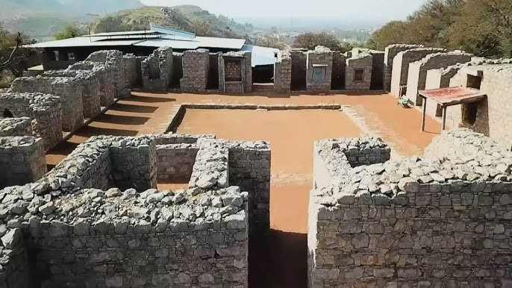
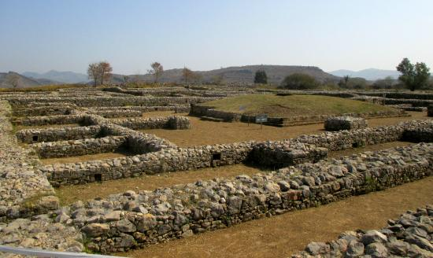
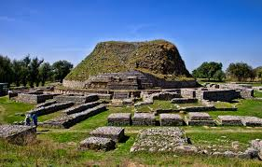
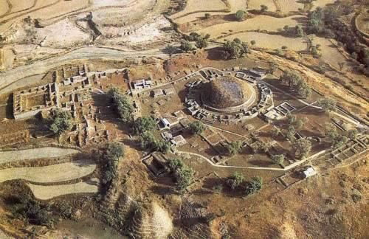

Slide 8
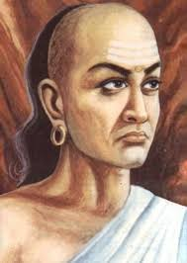
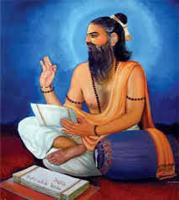


Slide 9
Decline and Preservation
Decline: Taxila’s prominence began to wane around the 5th century CE due to a combination of factors including invasions, political instability, and changes in trade routes. The university gradually declined and eventually faded from prominence.
Archaeological Significance: Today, the ruins of Taxila are an important archaeological and historical site. Excavations have revealed numerous remnants of ancient educational institutions, including lecture halls, residential quarters, and libraries, providing insights into the university’s structure and scholarly activities.

Slide 10
Taxila University stands as a symbol of the rich intellectual heritage of ancient India. Its role in advancing education, science, and philosophy during its time underscores the significance of ancient learning centers in shaping the intellectual history of the region. The legacy of Taxila continues to be a source of historical and cultural pride and a subject of study for scholars interested in the ancient educational traditions of South Asia.

Slide 11
NALANDA UNIVERSITY
Nalanda University was one of the most renowned ancient centers of learning in India and an influential institution in the history of education. Located in the Indian state of Bihar, near the modern village of Nalanda, it flourished between the 5th and 12th centuries CE.

Slide 12
Historical Context
Foundation and Growth
Founding: The exact date of Nalanda's founding is not precisely known, but it is commonly believed to have been established in the 5th century CE. The university was supported and expanded under the patronage of several Indian emperors, including the Gupta Empire and later rulers.
Expansion: Under Emperor Kumaragupta I (reigned 414–455 CE) and his successors, Nalanda grew into a major educational and cultural center. It attracted scholars from across Asia.

Slide 13
Educational Structure
Curriculum:
Diverse Disciplines: Nalanda offered a broad range of subjects including:
Buddhist Philosophy and Theology: As a major Buddhist center, it was renowned for its study of Buddhist texts and doctrines.
Philosophy: Including various Indian philosophical systems like Nyaya (logic), Vaisheshika (atomic theory), and Samkhya (philosophy).
Mathematics and Astronomy: Advanced study in mathematical concepts and celestial phenomena.
Medicine: Including medical knowledge and practices.
Grammar and Linguistics: Study of classical languages and their structures.
Political Science and Law: Study of governance, administration, and jurisprudence.

Slide 14
Teaching Methodology:
Oral Tradition and Debate: Learning involved extensive oral instruction, discussions, and debates. Students engaged in rigorous intellectual exchanges with teachers.
Residential System: The university had a residential system where students and scholars lived and studied on campus. It was akin to a large, self-contained academic community.
Faculty and Scholars:
Notable Figures: The university attracted many eminent scholars, including:
Aryabhata: A prominent mathematician and astronomer.
Vasubandhu: A noted Buddhist philosopher.
Dharmakirti: A significant philosopher and logician.
International Scholars: Scholars from various regions, including China, Korea, Japan, and Tibet, came to Nalanda to study.

Slide 15
Cultural and Intellectual Influence
Buddhist Learning:
Center of Buddhist Studies: Nalanda was a major center for the study and dissemination of Buddhist teachings. It played a key role in the development and spread of Mahayana Buddhism.
Pilgrimage Site: The university was a major pilgrimage site for Buddhists and attracted monks and scholars from different parts of Asia.
Influence on Asian Education:
Educational Model: The model of Nalanda influenced the development of other educational institutions across Asia, including in Tibet, China, and Southeast Asia.

Slide 16
Legacy:
Literary Contributions: Scholars at Nalanda made significant contributions to literature, science, and philosophy, leaving a lasting legacy on Indian intellectual traditions.
Modern Revival: Nalanda's historical significance has inspired the revival of the university in the 21st century, with the establishment of the new Nalanda University in 2010, which aims to revive the spirit of the ancient institution.

Slide 17
Archaeological Significance
Excavations:
Findings: Excavations at the site have uncovered extensive ruins, including lecture halls, residential quarters, libraries, and monasteries, which offer insights into the structure and functioning of the ancient university.
Architectural Remains: The site contains impressive architectural remains, including stupas, temples, and monasteries, reflecting the grandeur of the university.
UNESCO World Heritage:
Recognition: The ruins of Nalanda University have been recognized as a UNESCO World Heritage Site, underscoring their historical and cultural significance.

Slide 18
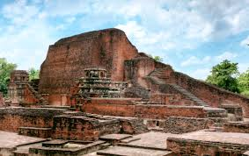
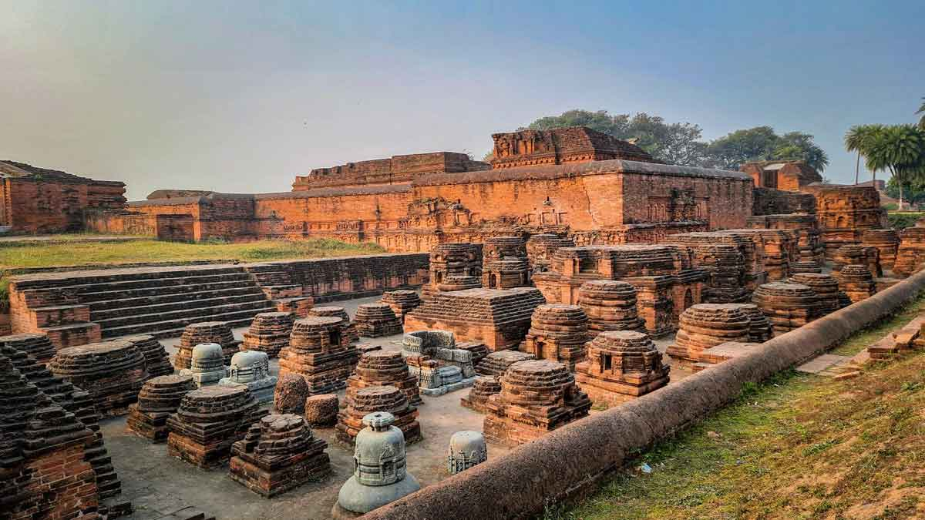
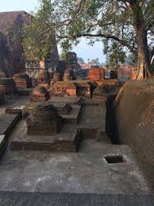
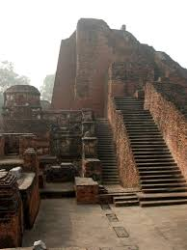

Slide 19
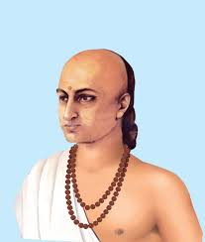
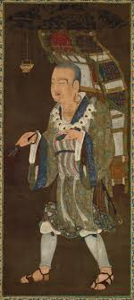
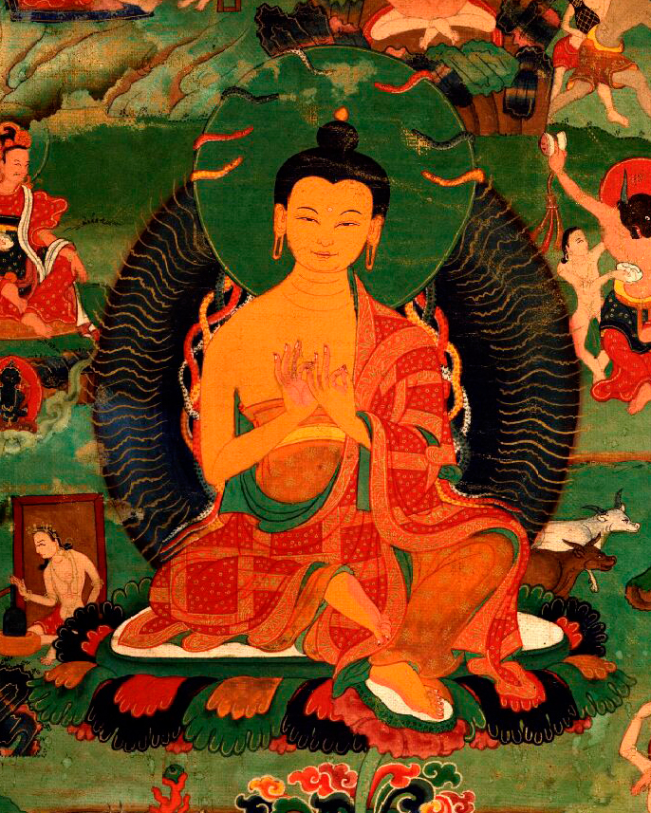
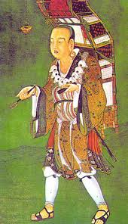
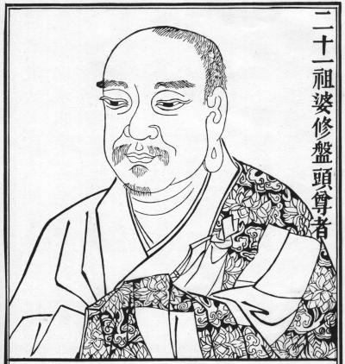

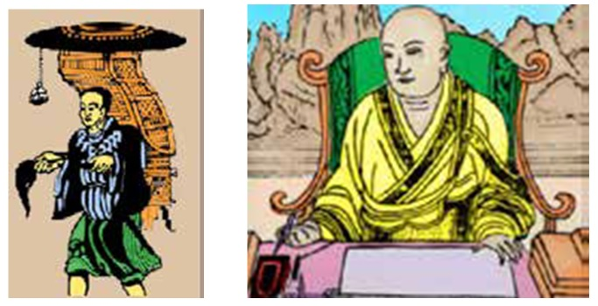

Slide 20
Decline and Fall:
Decline: Nalanda’s prominence began to decline in the 12th century, particularly with the invasions of the Turkish Muslim conqueror Bakhtiyar Khilji in 1193 CE, which led to the destruction of the university and its libraries.
Rediscovery: The site remained in ruins for centuries and was rediscovered by archaeologists in the 19th century.
Nalanda University was a beacon of learning and scholarship in ancient India, renowned for its intellectual rigor and cultural influence. Its contributions to education, philosophy, and Buddhist studies have had a lasting impact on Indian and global intellectual traditions. The site’s historical legacy continues to inspire and inform contemporary discussions about education and cultural heritage.

